Slide 1

UP SCHOOL DATA SCIENCE
Getir Data Case: Crimes in Boston

Slide 2

Content
Know How (15 min)
Know Self (5 min)
Q&A (5 min)

Slide 3
Know How
Problem & Goal
Data
EDA
1.Baseline Model
2.Model: Predict for each day for Ucr Part 3
3.Model: Predict district & location
All Models
Next Steps
What excited you about your capstone project?
What was the most challenging issue for you in the project? How did you get over it?

Slide 4
Problem & Goal
For me it is important that crime is predictable. Thus, Boston Police Forces can focus on specific districts on certain days. They can use existing human and other resources more efficiently.
In this study, I focused on 2 main problems.
A. How many crimes can be committed in a day?
B. In which region can the crimes be committed?

Slide 5
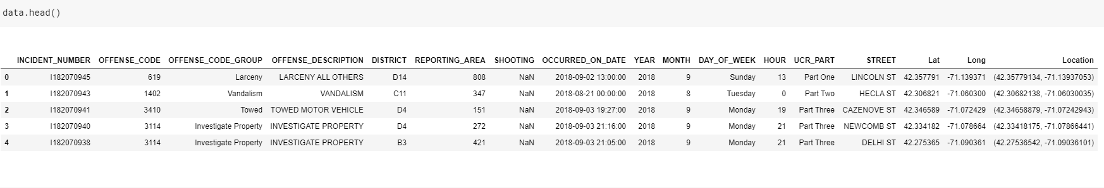
Data
Crimes in Boston data from Kaggle were used in the study. Data contains information about the crime such as date, location, crime group, crime code. It contains 319073 rows and 17 columns. The city’s tabular data lists crimes that took place from 2015 to 2018.

Slide 6
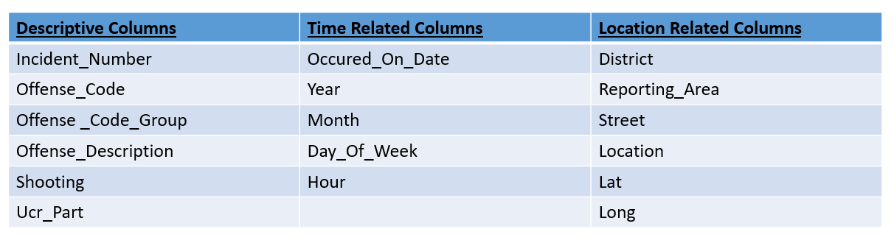
Data

Slide 7
EDA
Q1: How has crime changed over the years?
Q2: Is it possible to predict where or when a crime will be committed?
Q3: What can you say about the distribution of different offenses over the city?
https://www.kaggle.com/sengulkrdrl/boston-crime-analysis

Slide 8
A.Baseline Model
Our first goal is to predict the number of crimes that may occur in the future. Why is this important? Because if we know the number of crimes that can be committed, we can take action.
If more crimes are to be committed, a more intense shift may be applied that day.
The Police Department can focus on the day.
Equipment can be supplied according to the number of crimes.
Notes:
linear regression

Slide 9
Why linear regression?
After preparing our data, we will try to estimate the number of crimes that will occur per day. Here we will start by using linear regression as it is simple, easy to understand, easy to implement for baseline model.
Why didn't I want to apply time series?
Because my goal is to predict multiple variables together, it can be difficult for timeseries models. The forecast is determined only by the past behavior of the variable in timeseries. ARIMA is a univariate model (working with one variable only) and hence cannot exploit the leading indicators or explanatory variables.ARIMA requires a lot of time series observations in this dataset.But if we want to handle single variable we can use ARIMA. Our data has a time dimension so we can apply time series.

Slide 10
Why did I choose R-squared as the metric?
Because R-squared tells us how much of variance can be explained by the linear model. I want to develop model to explain the variation in Y.
R-squared is conveniently scaled between 0 and 1 and it can be compared with accuracy.

Slide 11
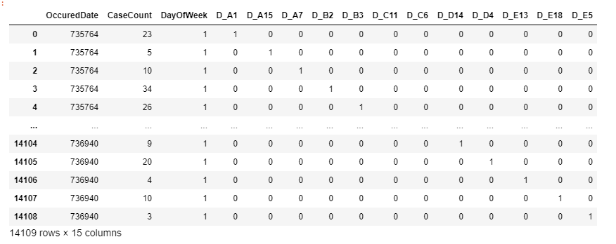
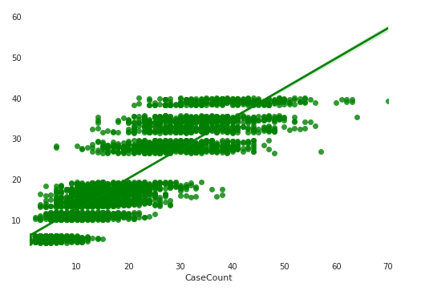
Input: Output:
Features: OccuredDate, Districts & DayofWeek
Target: CaseCount
R2 Score: 0.741
(Linear Regression)

Slide 12
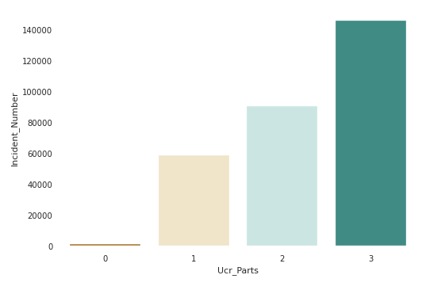
B.Model: Predict for each day for Ucr Part 3
We are now customizing the model. Ucr_Part 3 is the Ucr part type with the highest number of crimes. Therefore, we will try to estimate how many crimes can be committed from Ucr_Part 3 in the future.

Slide 13
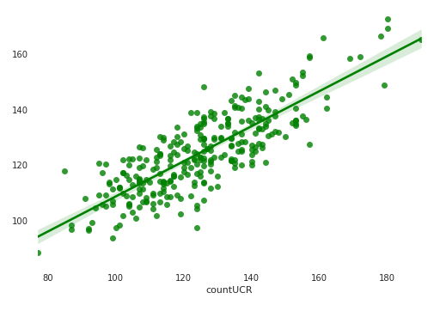
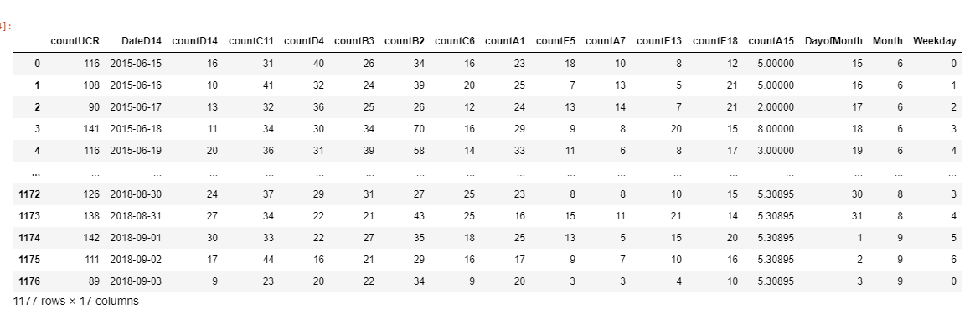
Input: Output:
Features: DateD14, DayofMonth, Month, Weekday, countD14,...
Target: countUCR
R2 Score: 0.665
(Linear Regression)

Slide 14
C.Model: Predict District
Now, we want to predict the region. If we can predict in which region the crime will occur, the police can work by focusing on the regions. It can help us plan and guide patrol cars. Patrol cars can route in busy places during peak hours.
In other words, it is important to predict in which district a crime may occur in order to prevent crime.

Slide 15
Why XGB Classifier?
We will be using XGB Classifier for its ease of use and predictive power.
There are too many rows in my dataset.
Why accuracy metric?
I'm just curious about the correct classifications.

Slide 16
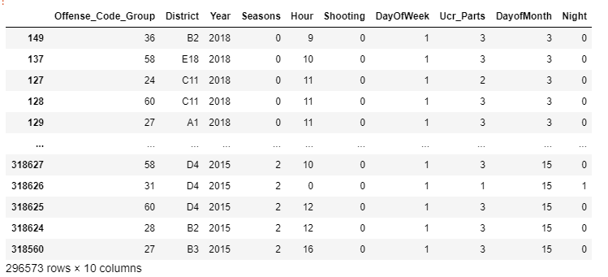
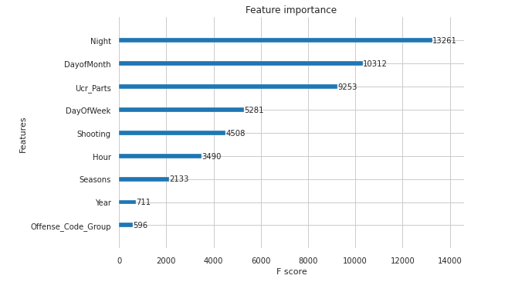
Input: Output:
Features: Year, Seasons, Hour, Shooting, DayOfWeek, Ucr_Parts,...
Target: District
Accuracy: 0.20
(XGB Classifier)

Slide 17
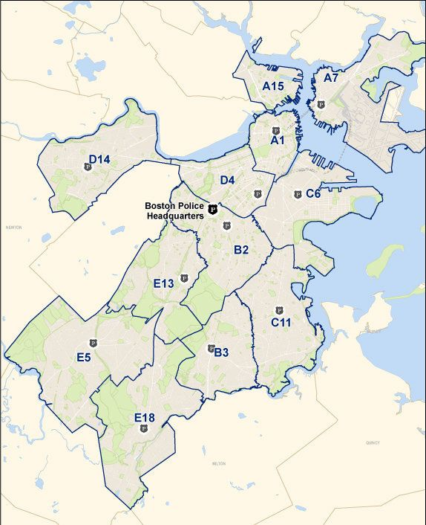
While predicting the districts, our model was not successful enough. The reasons for this may be the following.
Districts are close to each other and have no clear boundaries.
We have a large number of districts.
We don't have enough data.
For this reason, we will try to model the districts by grouping them among themselves. So I aim for better prediction.

Slide 18
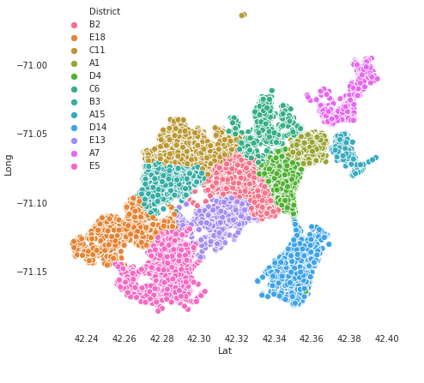
Model 3 with Grouped Districts
We divided the districts into 3 groups according to their distance.
We will try to classify the district groups.

Slide 19
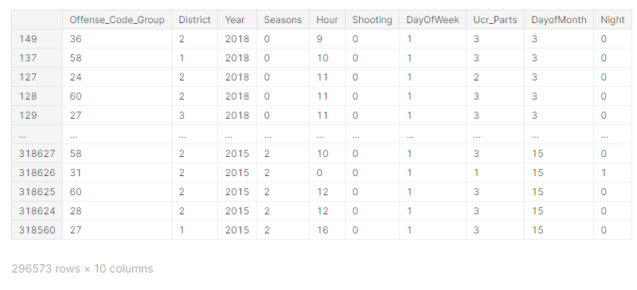
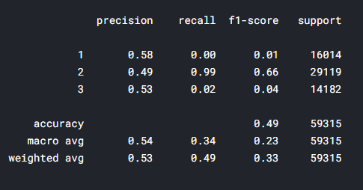
Input: Output:
Features: Year, Seasons, Hour, Shooting, DayOfWeek, Ucr_Parts
Target: District Group
Accuracy: 0.49
(XGB Classifier)

Slide 20
All Models
 | Model 1: | Model 2: | Model 3:
Predict: | The number of crimes that will occur per day | The number of crimes that will occur per day for Ucr_Part 3 | In which district group the crime can be committed
Model: | Linear Regression | Linear Regression | XGB Classifier
Metric: | R-squared: 0.74 | R-squared: 0.66 | Accuracy: 0.49

Slide 21
Next Steps
The dataset as such is not suitable for regression and classification problems.If we want to make a similar prediction or classification, a stronger preprocessing is required.
Multivariate Time Series can be applied to estimate the number of crimes that can occur in a given time period.
With the clustering method, we can identify cluster centers and insert them into the model as features. Also, when a crime occurs, the patrol car in the nearest center can quickly reach the crime position.
We can build a model for each district. Was this crime committed in D4 district?

Slide 22
What was the most challenging issue for you in the project? How did you get over it?
Asking the right questions to the data.I was worried that I was going to determine the problem. I have tried many things with the data.
Initially, I didn't know how to approach data. I overcame this by trying and working planned. I think this work has contributed a lot to me in understanding data.

Slide 23
What excited you about your capstone project?
To be looking for a real solution to a real problem. I think the answers I am looking for in this problem are similar in the industry. I wanted to create a really usable product.
Working with more complex data was challenging and at the same time I felt I was learning new things.

Slide 24

2. Know Self
In what areas do you think you have improved during your experience at UP School?
In which area will you continue to improve yourself from now on?

Slide 25
In what areas do you think you have improved during your experience at UP School?
Clarity of Purpose
Solving Challenging Problems
Time Management
Lifelong Learning
Feed Forward
Together

Slide 26
In which area will you continue to improve yourself from now on?
I want to work as a data scientist, apply what I have learned here and solve different problems. In the second phase, I plan to do a master's degree in order to have deeper knowledge in research. I think the industry and the academy feed each other. Therefore, there are things to learn from both.

Slide 27
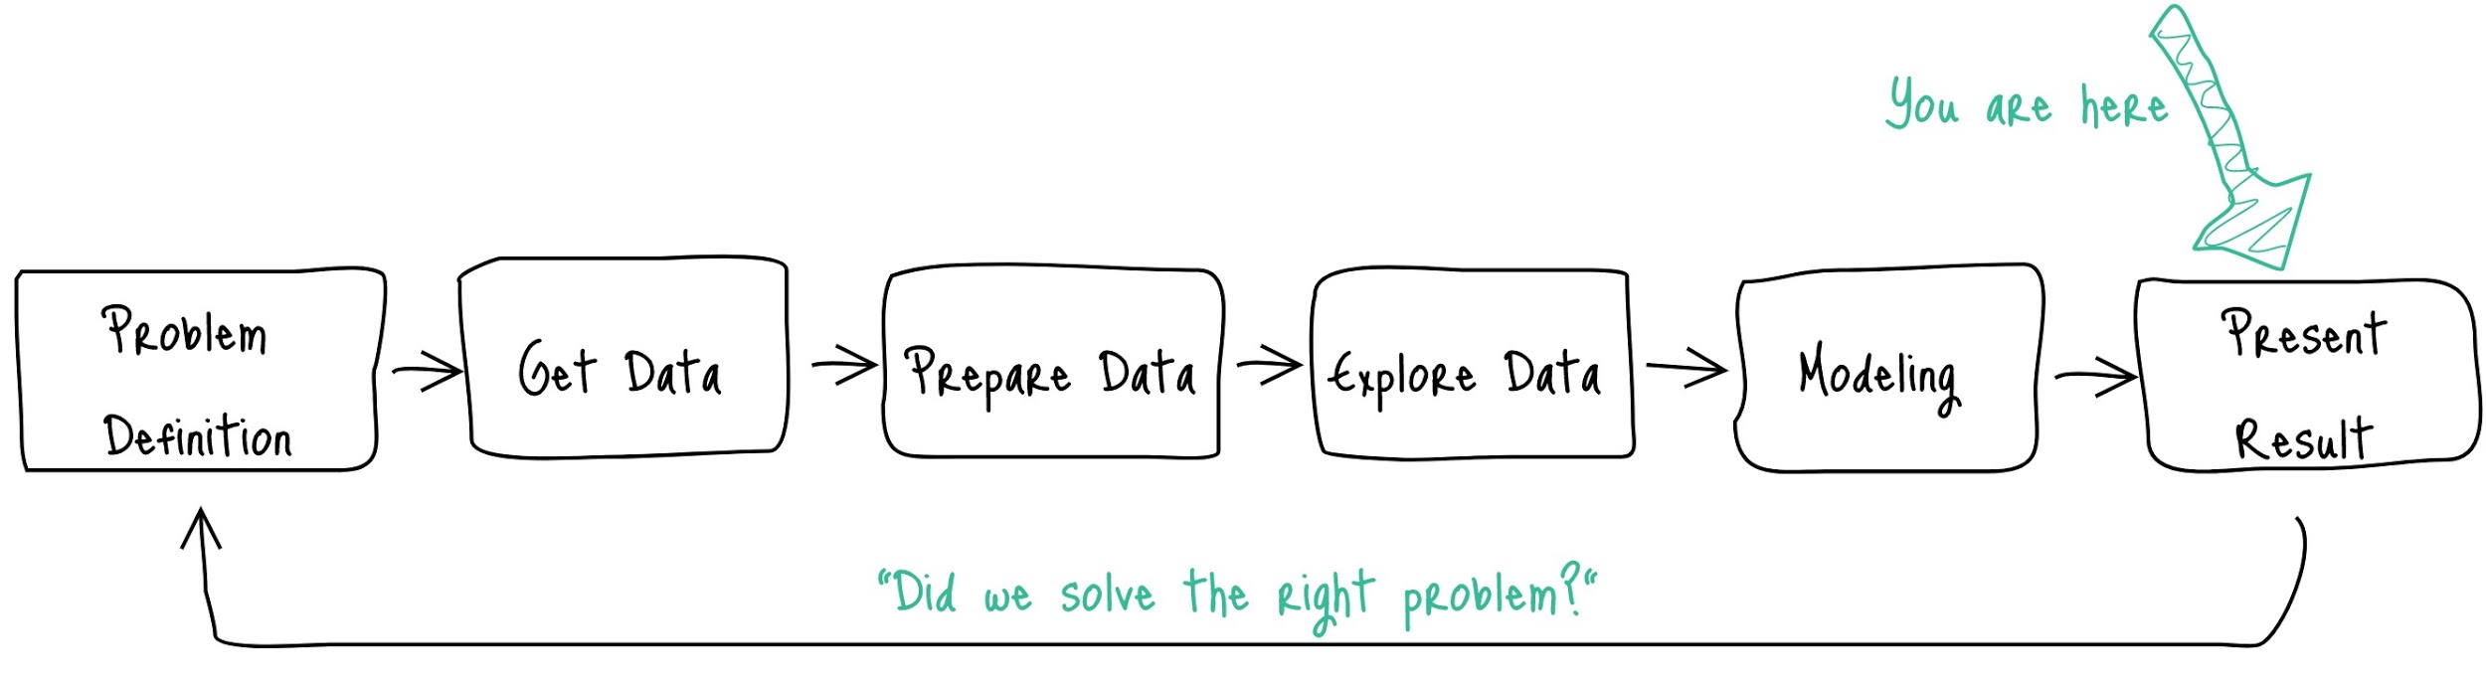
3. Q&A

Slide 28
Thank you for listening!
Şengül Karaderili
sengulkaraderili@gmail.com

